Slide 1
AMAZON SAles
Data analysis

Slide 2

Agenda
Objectives
Problem Statement
About Data
The Process
Data Analysis
Insights
Summary

Slide 3
objective
To calculate total sales, total profit, average profit and average price
To find which order priority gave highest sales
To find which is the bestseller Item type
To find which mode of channel generated maximum sales
To find yearly total profit
To find total sales and total profit by region
To find the number of units sold of a particular item type

Slide 4

Problem statement
AMAZON is an E-commerce company, and their Sales management team has gained importance to meet increasing competition and the need for improved methods of distribution to reduce cost and to increase profits.
As Sales management today is the most important function in a commercial and business enterprise.

Slide 5
About data
Performed ETL (Extract-Transform-Load) on Amazon dataset to find Sales Trend : Month-wise, Year-wise, Yearly Month-wise.
Found KPIs and factors to show the meaningful relationships between attributes.
Recognizing sales management as the cornerstone of success in the commercial and business landscape.
Showcasing the power of visual representation through a dynamic Power BI dashboard.
Utilizing a diverse set of visualizations, including clustered column charts, line charts, tree maps, filled maps, slicers, and cards, to present a comprehensive view of sales data.
Unearthing insights into monthly and yearly sales trends, unit sales correlations, regional profit dynamics, and order priority analysis. Enabling strategic decision-making in sales strategies, inventory management, and resource allocation.

Slide 6
The process
Data Collection
Data Cleaning
Insights
Data Analysis
Summary

Slide 7
Data collection
The Data has been collected in the form of a CSV file named “Amazon Sales Data.csv”.
The CSV file has the data of sales of products during the timespan of 2010 and 2017.

Slide 8
Data cleaning
There were no Null values or blank fields
Some values in ‘Order Date’ and ‘Ship Date’ columns are in String datatype. So we converted them to datetime datatype using Python
Most of the values in ‘Total Revenue’, ‘Total Cost’ and ‘Total Profit’ columns are written with two decimal places, so we make sure that each value in these columns have two decimal places by using Excel.

Slide 9
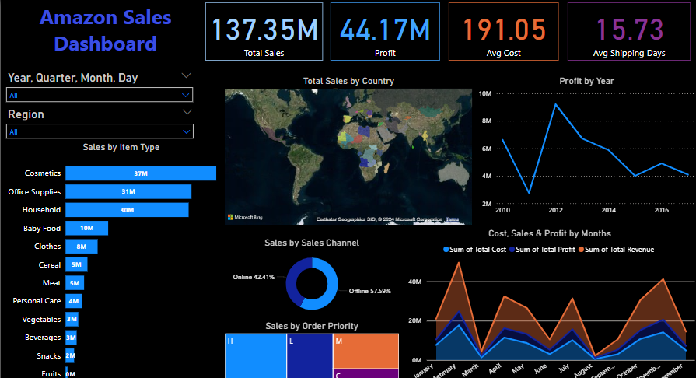
Data analysis

Slide 10
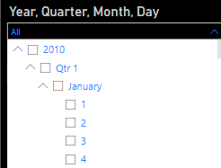

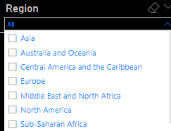
Data analysis
FILTER IN DASHBOARD
Filter by
Year> Quarter> Month> Day
Filter by
Regions Amazon is catering

Slide 11
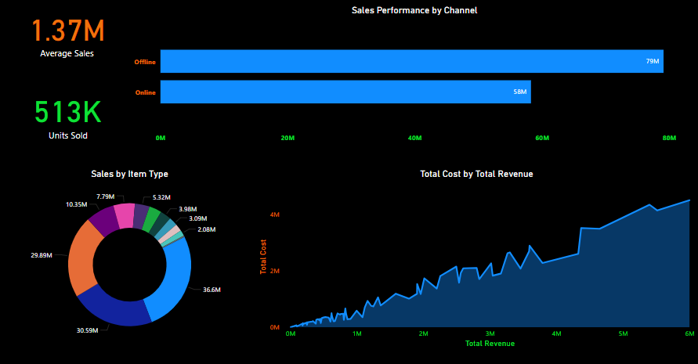
Data analysis

Slide 12
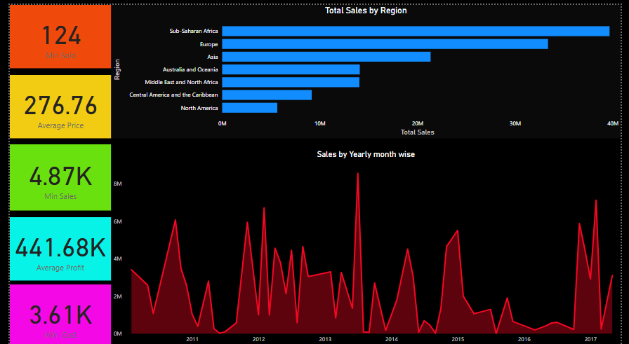
Data analysis

Slide 13
Insights
Monthly Sales Trends:
Highest sales occurs in February with $24,740,517.77.
Lowest sales occurs in August with $1,128,164.91.
Yearly Sales Trends:
The Highest sales in 2012 with $31,898,644.52.
The Lowest sales in 2015 with $12,427,982.86.
Total Revenue and Costs:
Total Revenue generated from 2010-2017 is $137.35 Million
Total Cost is incurred is $93.18 million
Total Unit Price is $27.68k
Total Unit Cost is $19.10k

Slide 14
insights
Order Priority Analysis:
Order Priority 'H' has sold the most number of units i.e 154,212
Order Priority 'M' has sold the least number of units i.e 94,832
Region-wise Profit Analysis:
Sub-Saharan Africa has generated highest profit in offline sales (approx. $7.8 M) and is the second-highest in online sales.
Europe has the highest profit in online sales (approx. $5.5 M) and the second-highest in offline sales.
Revenue by Item type :
Household Items have the highest Total Revenue in Offline sales approx. $29.7 M
Cosmetics Item have the highest Total Revenue in Online sales approx. $18.3 M

Slide 15
Summary
Cosmetic products are very popular among people of Europe and these products generated the highest profit ($14.56 million) of all items. So, it is advisable to create some marketing campaigns promoting Cosmetic products.
Total Population of North America prefer to shop offline as compared to people of Europe, who mostly prefer Online channel for shopping. But because high profits are coming from Online channel, it advisable to promote products online.
The Region Sub-Saharan Africa has generated the highest profit where people bought Fruits the most, with approx. 31 thousands unit sold. Highlight the health benefits of fruits during campaigns and align marketing with local preferences.
The second most purchased item, after Cosmetics in Europe is Baby Food. This insight tells us that majority of people of Europe are newlywed couples. Thus, you can promote products related to newborn babies to these people.

Slide 16
Summary
Fruits has generated the least profit of all item types which is only $120.50 thousands. It is advisable to understand the customer needs, adjust the price and analyse the local preference.
North America Region has generated the least profit by selling only Personal Care and Household Items through Offline Channel. Try to promote products other than both these item types through Online Channel by giving some discounts. Do some survey to find local people’s preferences.
Meat is the least sold item type with 11 thousands units sold in Australia and Oceania and Sub-Saharan Africa Region using only Online Channel. Consider selling different kinds of meat products and adjust the prices.
Household Items and Cosmetic Products are sold the most through Offline and Online Channels, respectively. Enhance physical stores with attractive displays and promotions for Household Items. Run targeted ads and make the website more user friendly for Cosmetic products.

Slide 17
Thank you

